Slide 1
Making of the Ignite Bot
CLD332
Jordan Knight
Senior Technical Evangelist
Tim Hill
Senior Consultant – Modern Apps

Slide 2
Agenda
Why a bot?
Bot Framework
Understanding Natural Language
Handling FAQs
Fall through
Language Translation
Telemetry
Lessons Learnt

Slide 3
Why a bot?
A bot is a user interface
Figure out what benefit a conversational interface is
It should be more than just a search engine
People know how to use a search engine, and are probably more used to using one
Bots can do more: perform actions, understand natural language, recognise entities etc.
What problem are you trying to solve?
Help me find a session
Manage my session schedule (add, remove sessions)
General event Q&A
Chit-chat
https://github.com/jakkaj/SimpleBot

Slide 4
Demo
Using the bot

Slide 5
Bot Basics
Built with Web API and C#
Can manually intercept simple actions
Helper classes make it easier
Head over to https://dev.botframework.com/ for Bot emulator and Bot Builder SDK
https://github.com/jakkaj/SimpleBot

Slide 6
Demo
Luis.ai

Slide 7
LUIS
Can get an account free, need a Microsoft Account and Azure account for subscription key
Gets better over time, especially with real data
Intents usually map back to fairly distinct use cases
https://github.com/jakkaj/SimpleBot

Slide 8
Demo
Integrating LUIS

Slide 9
Integrating LUIS
Override LuisDialog base class and add intents
Can always call LUIS manually as a web service
Decorate methods with LuisIntentAttribute and class with LuisModelAttribute
Work with the IDialogContext serializable object
https://github.com/jakkaj/SimpleBot

Slide 10
No Intent
Fall-through logic:
LUIS (powerful, targeted intents, with extra smarts)
QnA Maker (simple, scalable)
Azure Search (catch-all, best guess)
https://github.com/jakkaj/SimpleBot

Slide 11
Demo
QnA Maker
Notes:
\

Slide 12
QnA Maker
Great for large numbers of questions
Easy to update on the fly
Uses ML to improve over time
https://github.com/jakkaj/SimpleBot

Slide 13
Azure Search
Simple indexer attached to a web job
Hook up to Event Management API
Powerful Lucene query syntax
Created a simple all search to catch fall-through queries
“Office 365”
Fuzzy Search good for presenters:
Gorden~ Night~
Gorrdn~0.2 Naght~0.2
Jorden~0.9 Knight~0.9
https://github.com/jakkaj/SimpleBot

Slide 14
Demo
Translation

Slide 15
Translation
Build the bot in your language
Bing Translator will translate automatically
https://github.com/MSFTAuDX/BotTranslator
https://github.com/jakkaj/SimpleBot

Slide 16
Translation
Build the bot in your language
Bing Translator will translate automatically
https://github.com/MSFTAuDX/BotTranslator
https://github.com/jakkaj/SimpleBot

Slide 17
Other Pieces
App Insights
RedisCache
Publishing
https://github.com/jakkaj/SimpleBot

Slide 18
Lessons Learnt
Order of Logic
LUIS → QnA Maker → Search : works well in most cases
For short queries, might have been better to go straight to search
Sometimes had to train LUIS, QnA Maker to not answer a question
Deployment
Train LUIS in dev, publish App JSON file to prod
Allows for better version control
Think about overlapping intents
Ideally, LUIS works best with distinct intents
This makes it easier for a human trainer as well

Slide 19
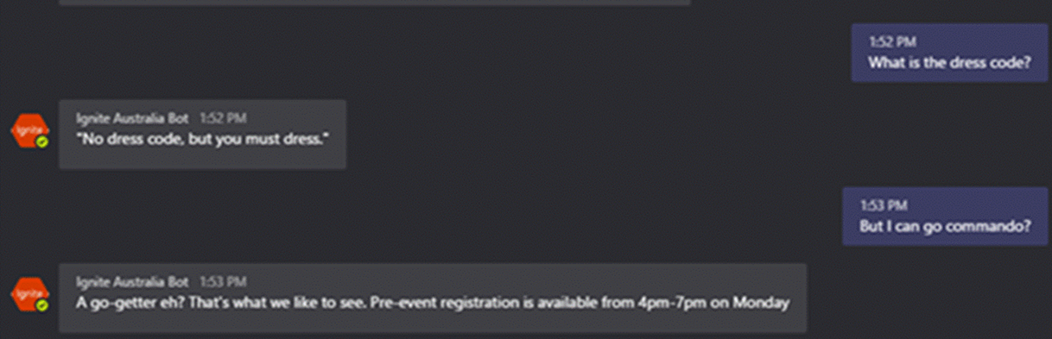
Lessons Learnt (cont)
QnA Maker
Avoid Open-ended answers. Repeat the question if needed.

Slide 20
Lessons Learnt (cont.)
Bing Spellcheck API
Add-on to LUIS. Nice to have in most cases
Doesn’t work well with session codes
Publish the bot well beforehand
We didn’t want it discoverable before the keynote, but unpublished bots are user-limited
Translation
https://github.com/jakkaj/SimpleBot

Slide 21
Continue your Ignite learning path
Visit Channel 9 to access a wide range of Microsoft training and event recordings https://channel9.msdn.com/
Head to the TechNet Eval Centre to download trials of the latest Microsoft products http://Microsoft.com/en-us/evalcenter/
Visit Microsoft Virtual Academy for free online training visit https://www.microsoftvirtualacademy.com

Slide 22

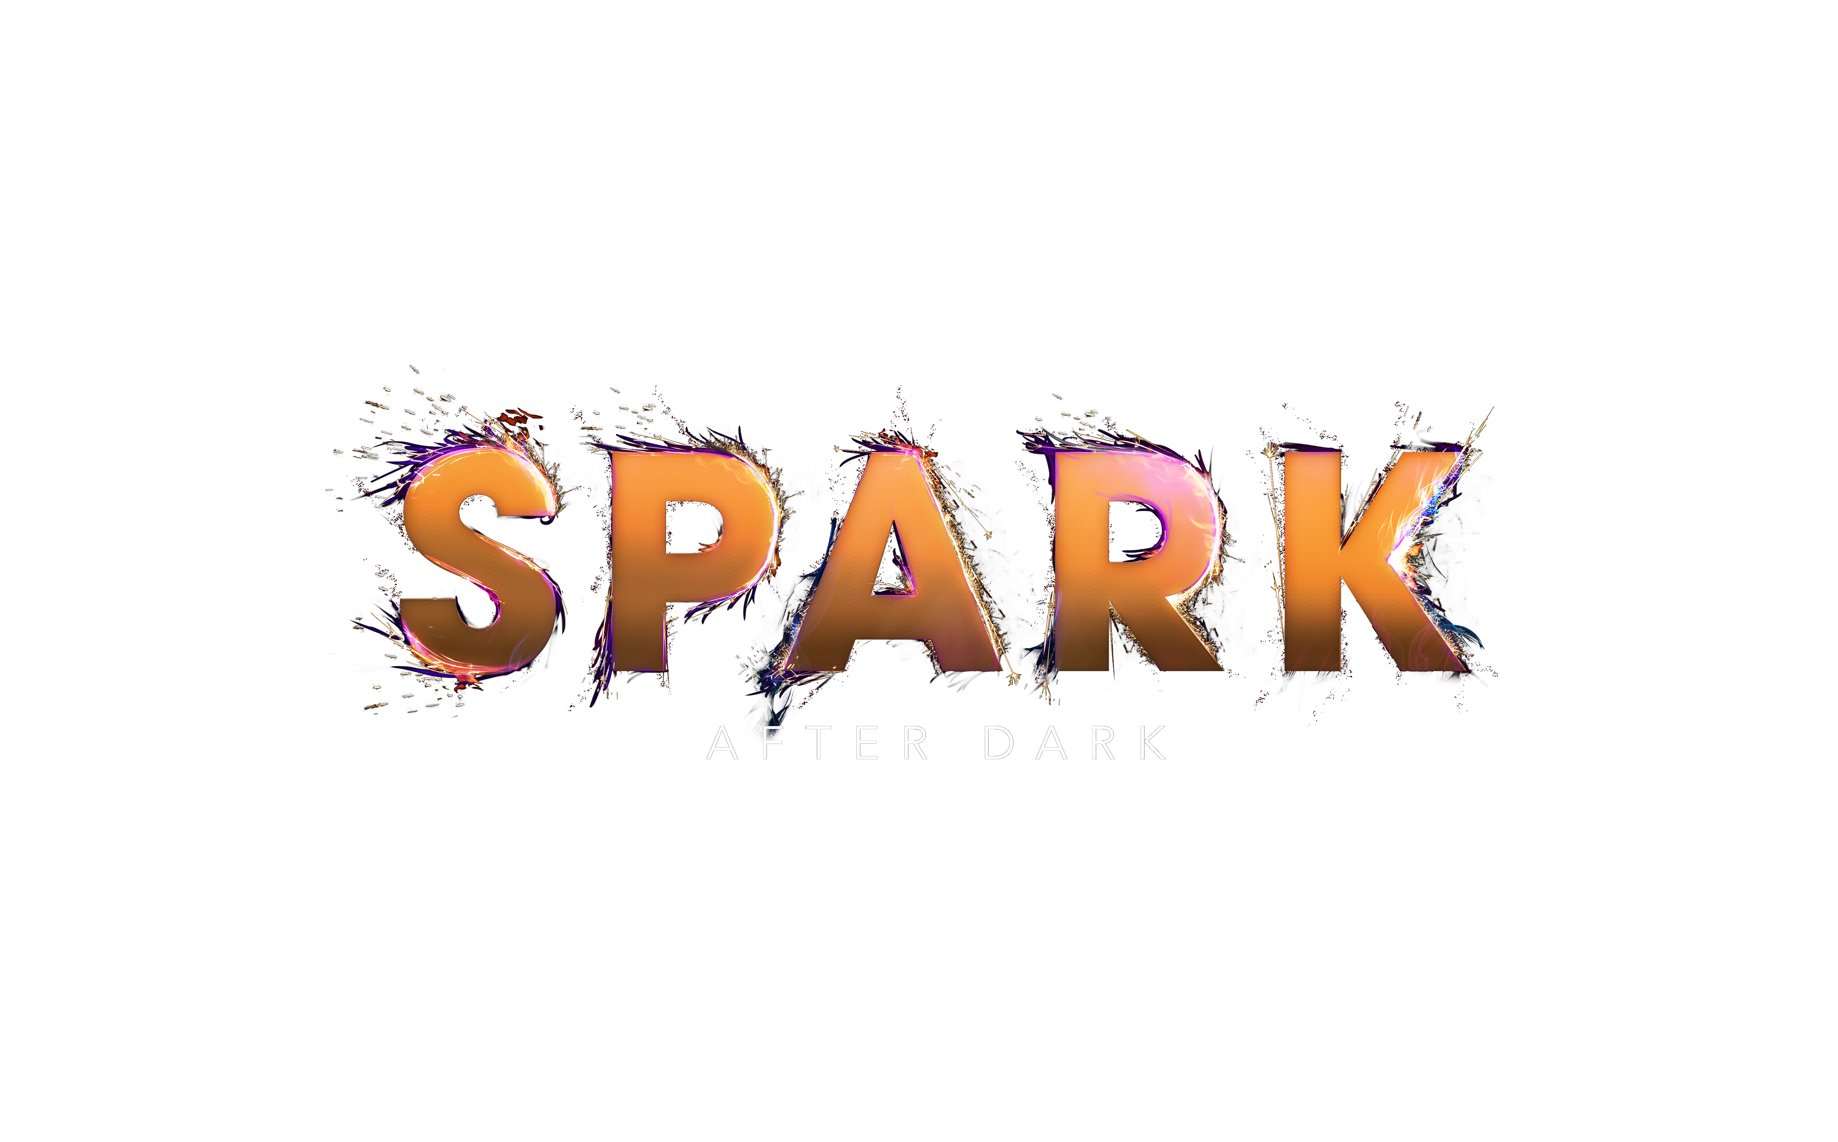
Win a Spark After Dark drone pilot pass by completing your session evaluation ASAP #MSAUIGNITE

Slide 23
Remember to collect your wristbands for Spark After Dark! Located at Ignite Help Desk, Foyer C, Foyers Halls ¾ #MSAUIGNITE

Slide 24
Thank you Chat with me in the Speaker Lounge

